Slide 1

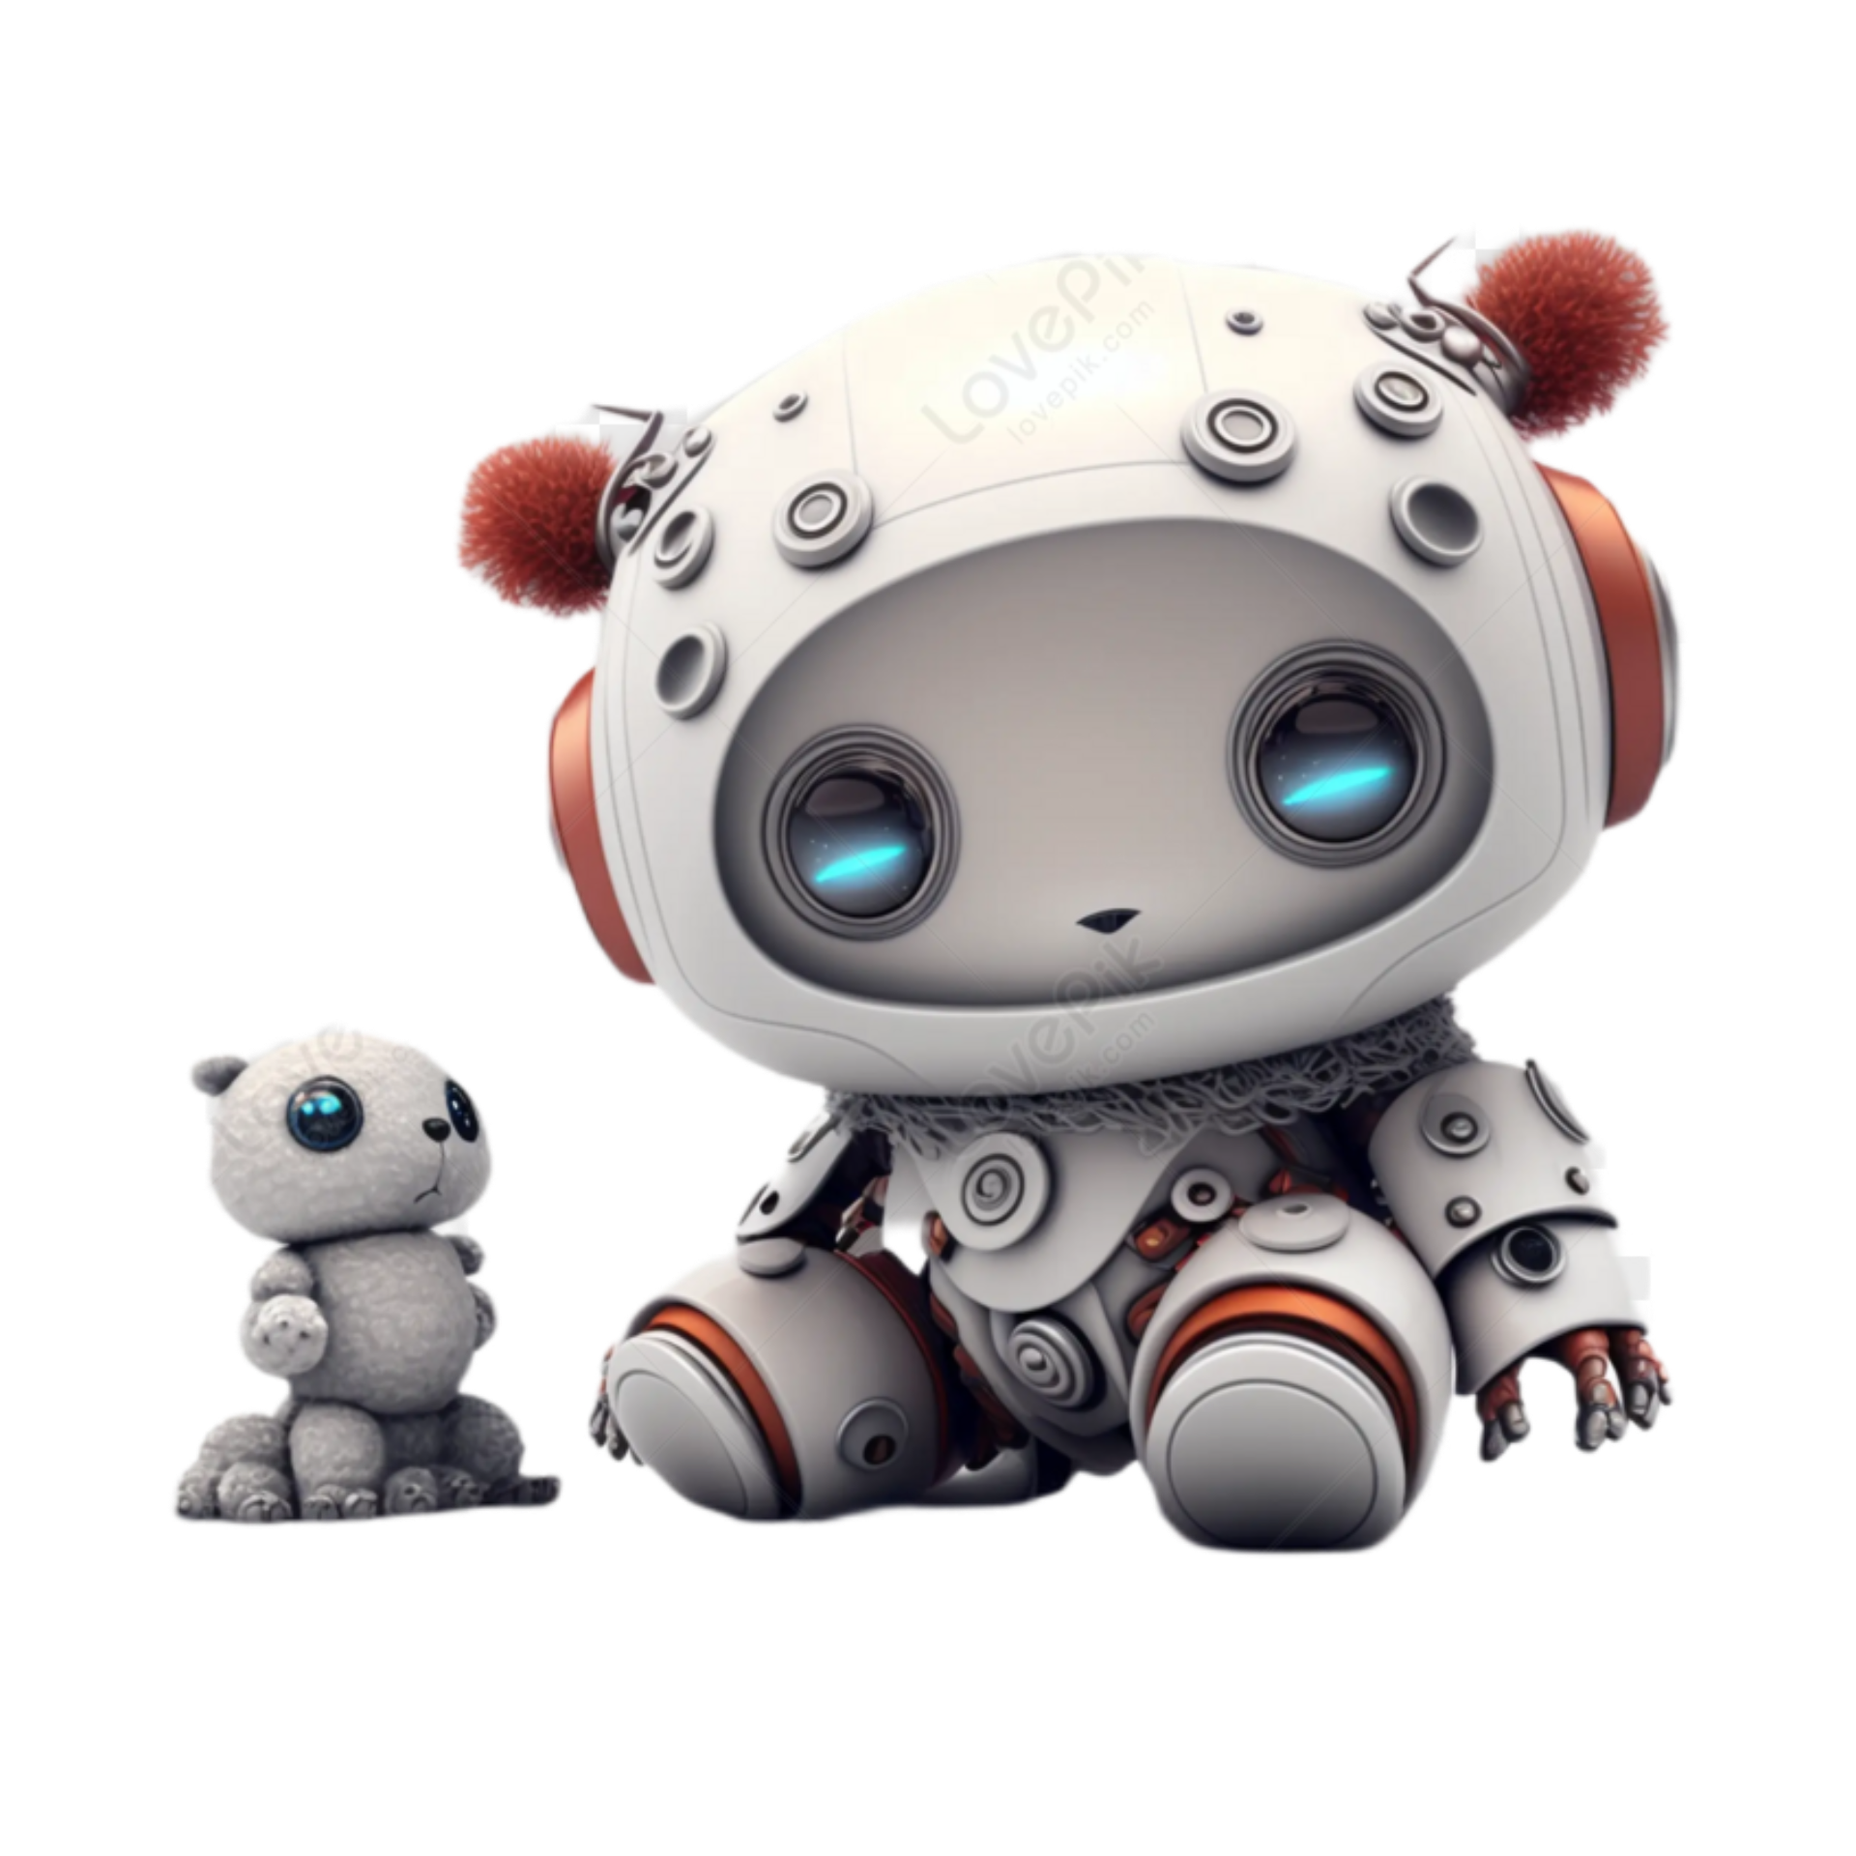
STUDENT NAME: Priya.M
REGISTER NO AND NMID: 30430424u18032
NMID :E520FB80B0CFF5C99D54872CA9784ADE
DEPARTMENT: Bsc. Computer Science
COLLEGE: Aringer Anna Arts and Science College/ Thiruvallur University

Slide 2
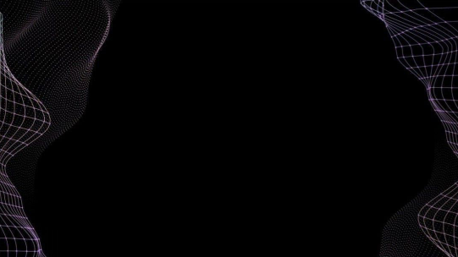
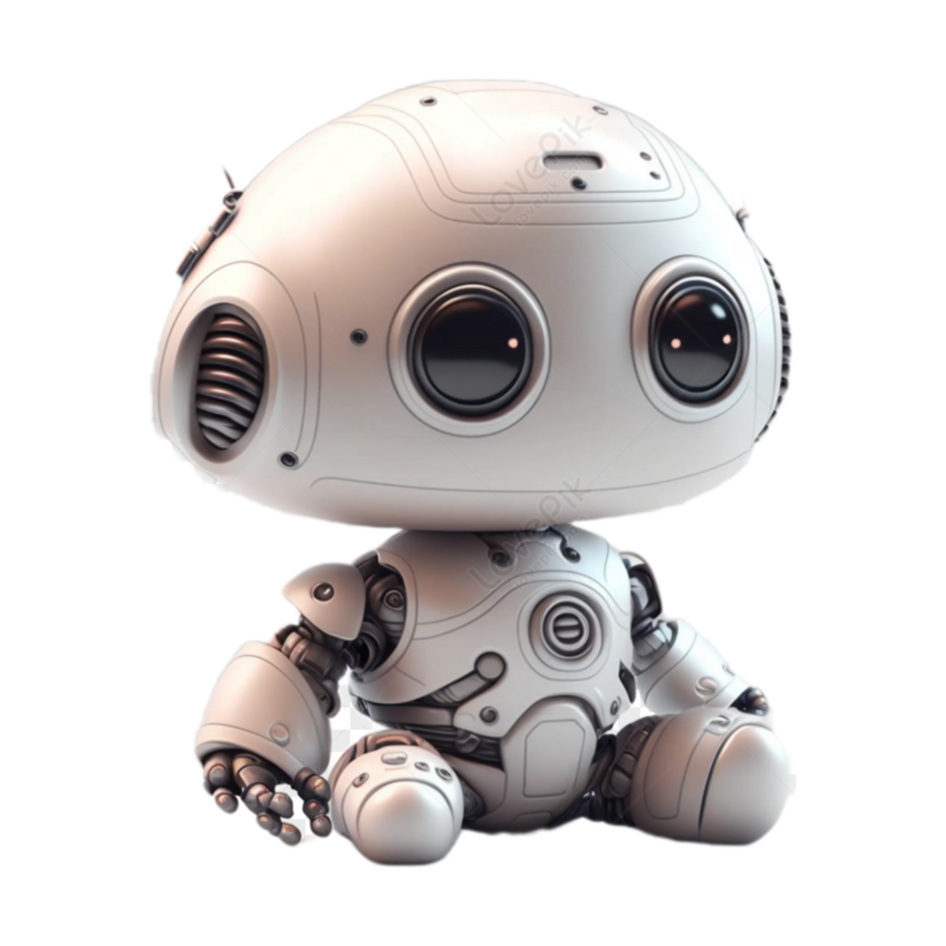
PROJECT TITLE
“AI-Powered Holographic Resume System”

Slide 3

AGENDA
Problem Statement
Project Overview
End Users
Tools and Technologies
Portfolio design and Layout
Features and Functionality
Results and Screenshots
Conclusion
Github Link

Slide 4
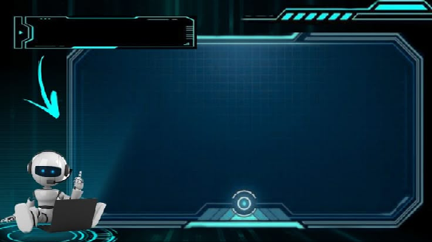
PROBLEM STATEMENT
1 . Normal resumes & portfolios are boring, flat, and limited.
2.Employers don’t get a real sense of the student’s personality and creativity.
3.Students need a futuristic way to stand out in placements.

Slide 5

PROJECT OVERVIEW
• This project proposes a Digital Portfolio 2.0 → a resume that comes alive in 3D hologram / AR (Augmented Reality).
• Students upload their details, projects, and certificates.
• Portfolio generates an interactive holographic avatar that presents skills to recruiters.
• Employers can scan a QR code → see the student’s AR/VR resume in 3D.

Slide 6

WHO ARE THE END USER'S
🎓Students – showcase skills in futuristic way.
🏫 Colleges – placement cell innovation.
💼 Employers – immersive recruitment experience.

Slide 7

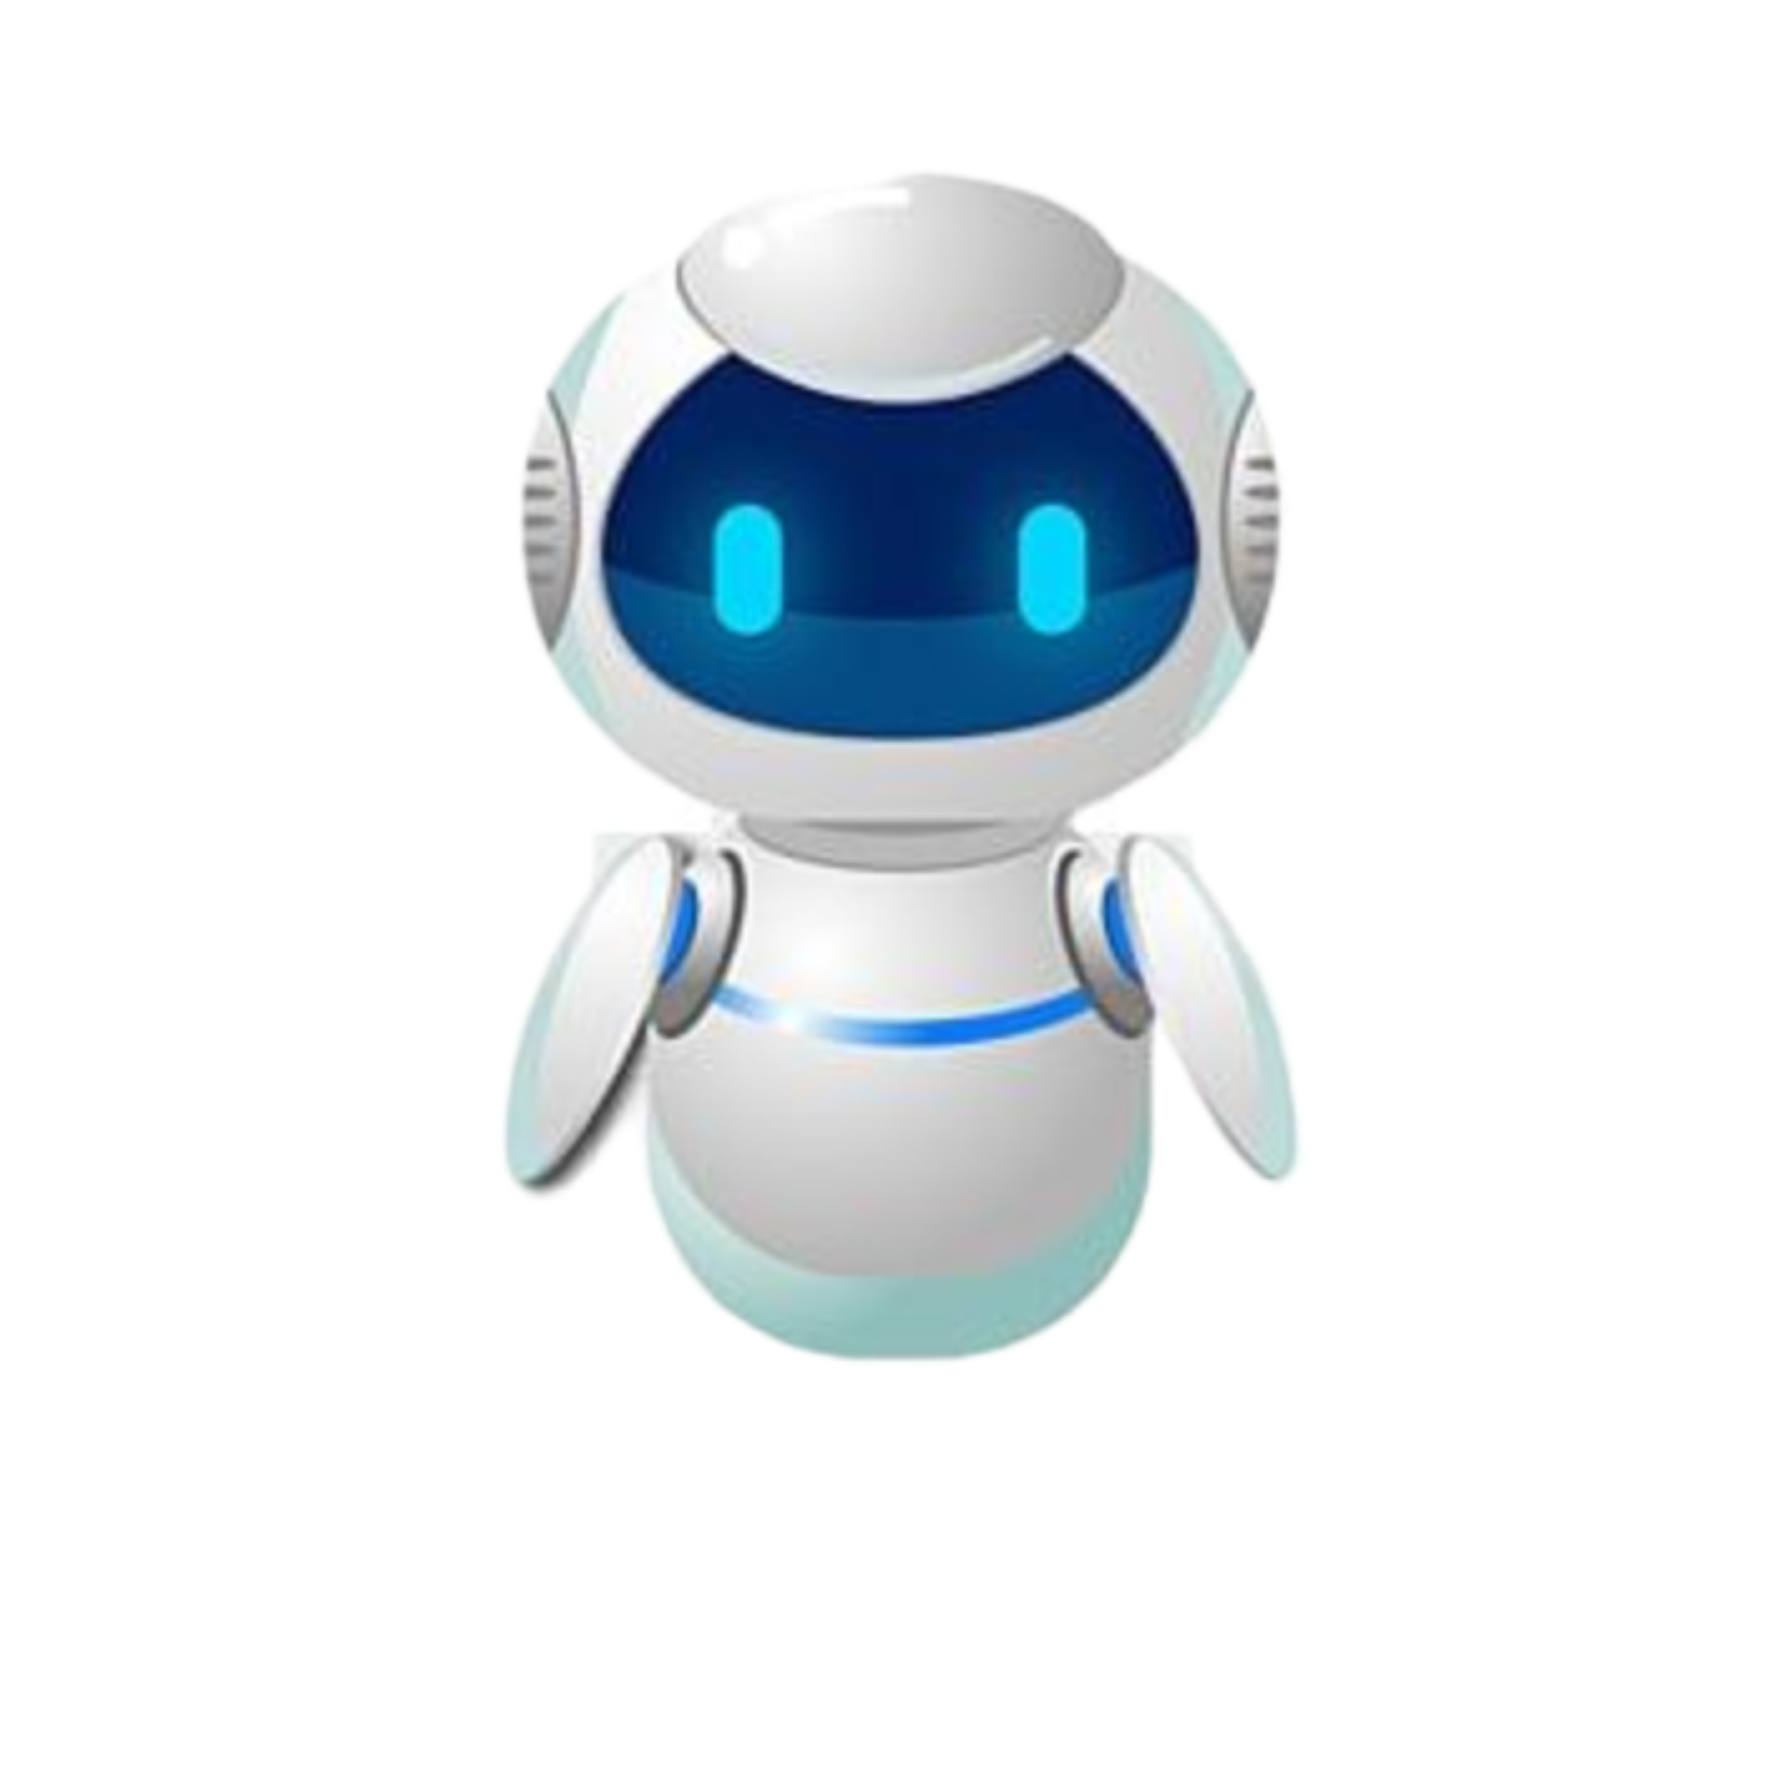
TOOLS AND FUNCTIONALITY
AR Tools (Blender / Unity 3D for concept).
AI Avatars (text-to-speech + animation).
QR Code Generator → to access holographic portfolio.
WPS Presentation → for the project documentation.

Slide 8
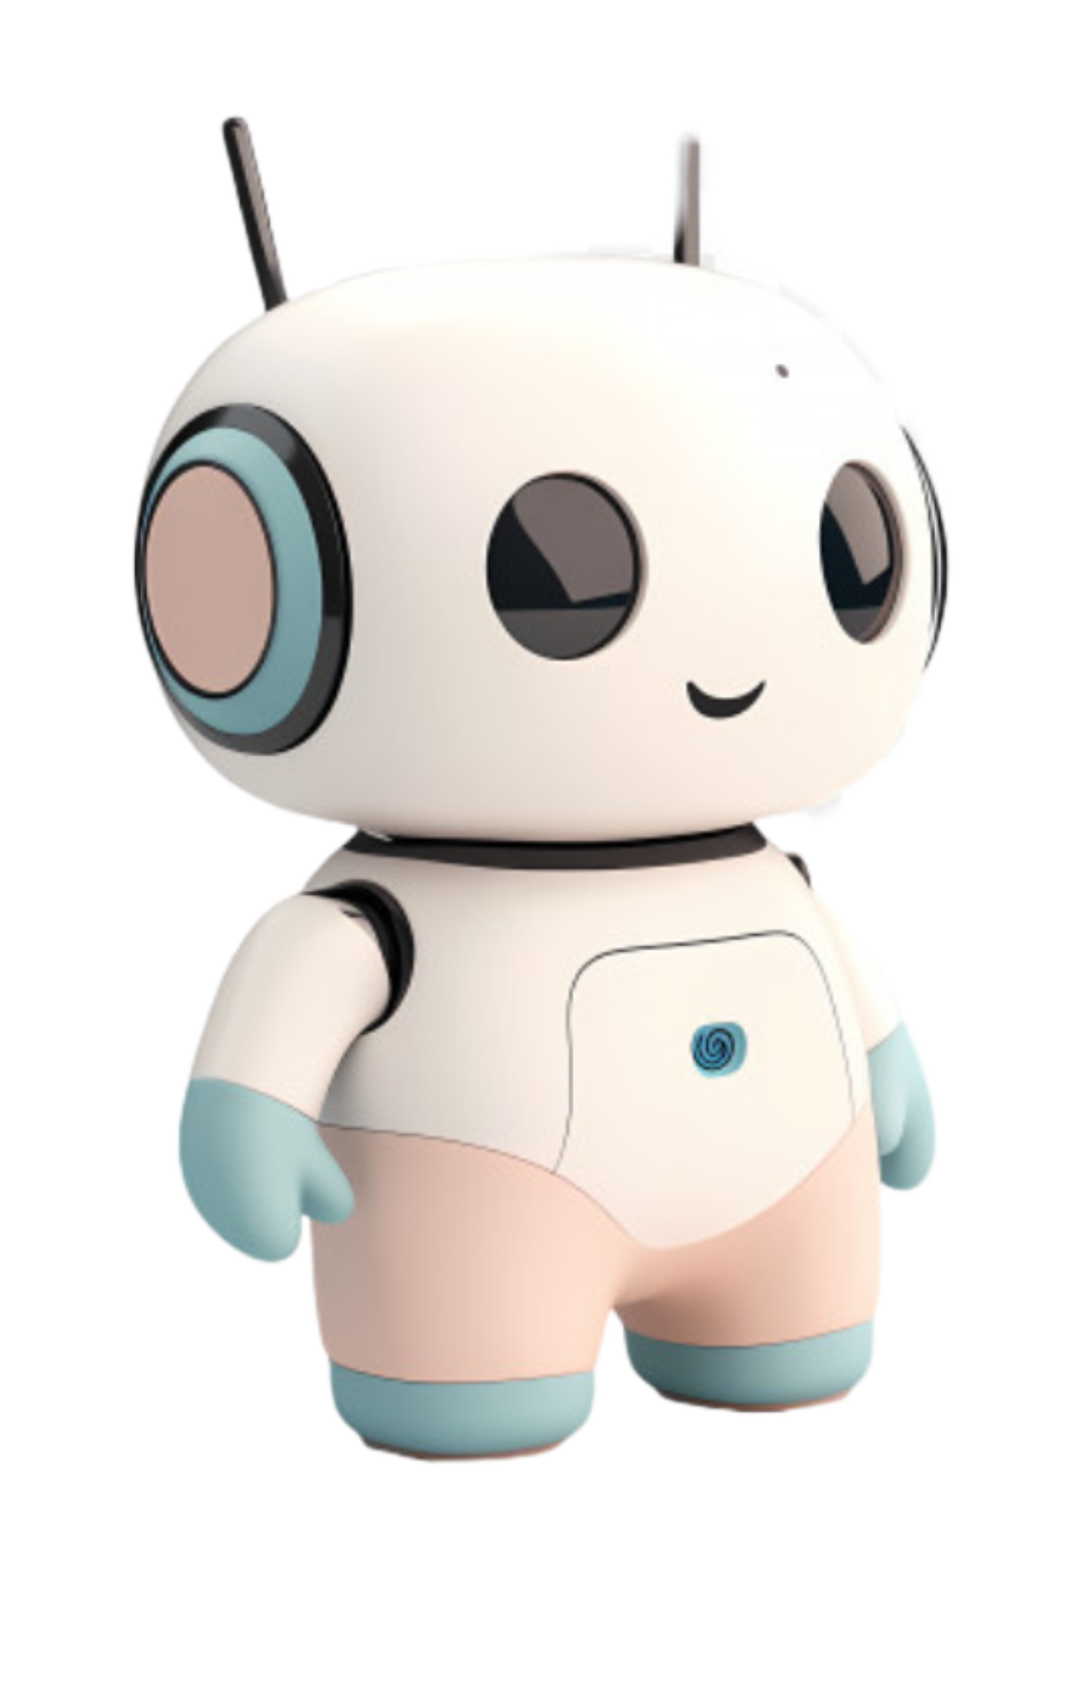
PORTFOLIO DESIGN AND LAYOUT
1️⃣ Home Page – Student name, photo, tagline, and quick introduction.
2️⃣ About Me – Career goals, passions, and strengths.
3️⃣ Education Timeline – Year-wise display of academic progress.
4️⃣ Skills Section – Technical and soft skills shown with icons and progress bars.
5️⃣ Projects Showcase – Screenshots and short descriptions of completed projects.
6️⃣ Certificates & Achievements – Digital badges and scanned certificates in a gallery view.
7️⃣ Hobbies & Interests – Icons representing personal interests and creativity.
8️⃣ Contact / Connect With Me – Email, LinkedIn, GitHub, and a QR code for quick access.

Slide 9
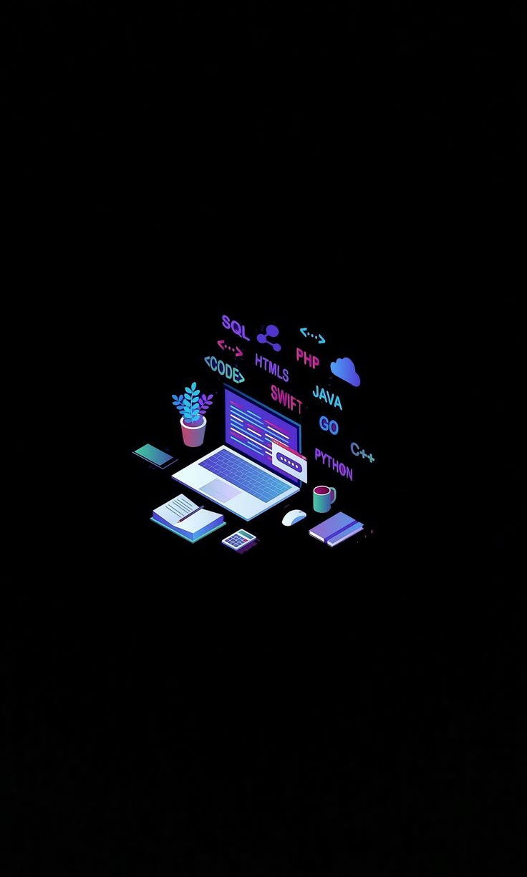
FEATURE AND FUNCTIONALITY
✔ 3D holographic avatar introduces student.
✔ Interactive projects & certificates (clickable in AR).
✔ QR code to instantly access profile.
✔ Futuristic, never-seen-before resume concept.

Slide 10
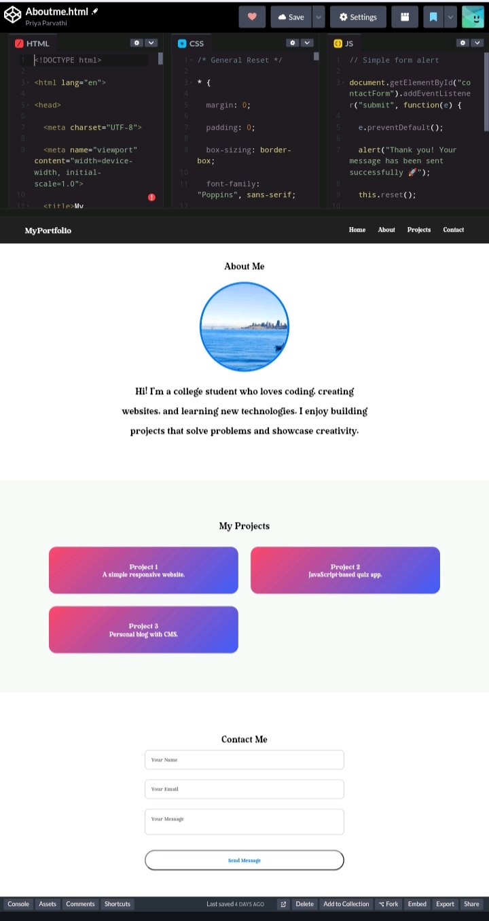
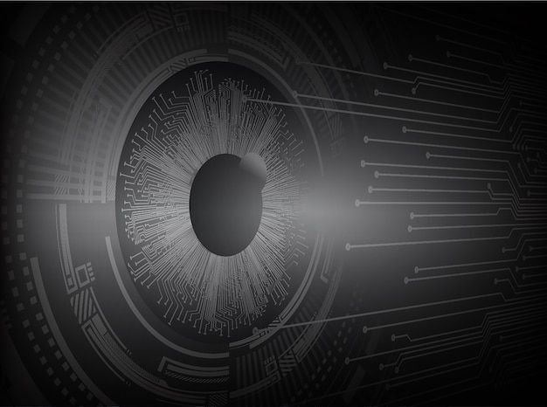
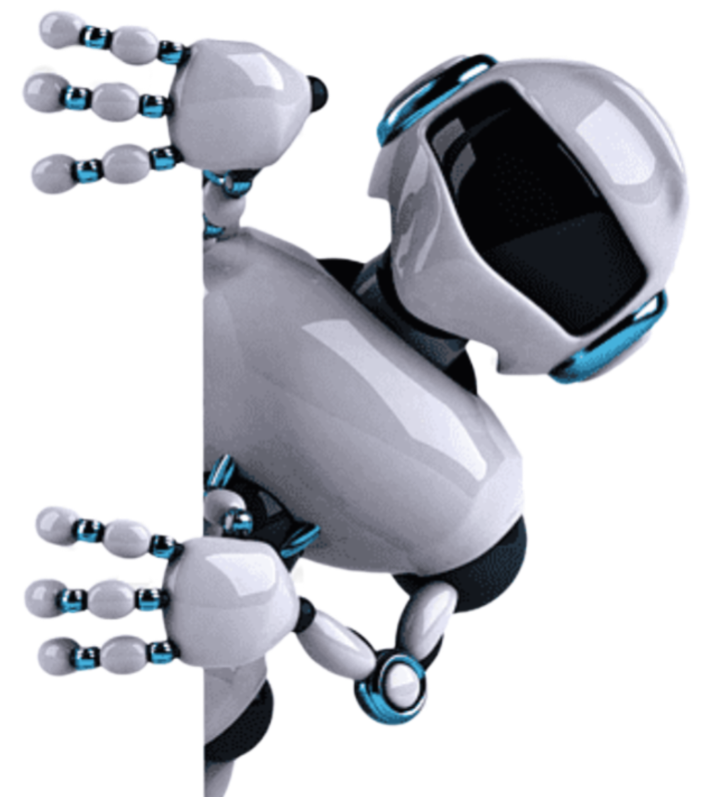
RESULT AND SCREENSHOTS

Slide 11
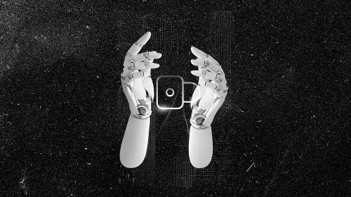
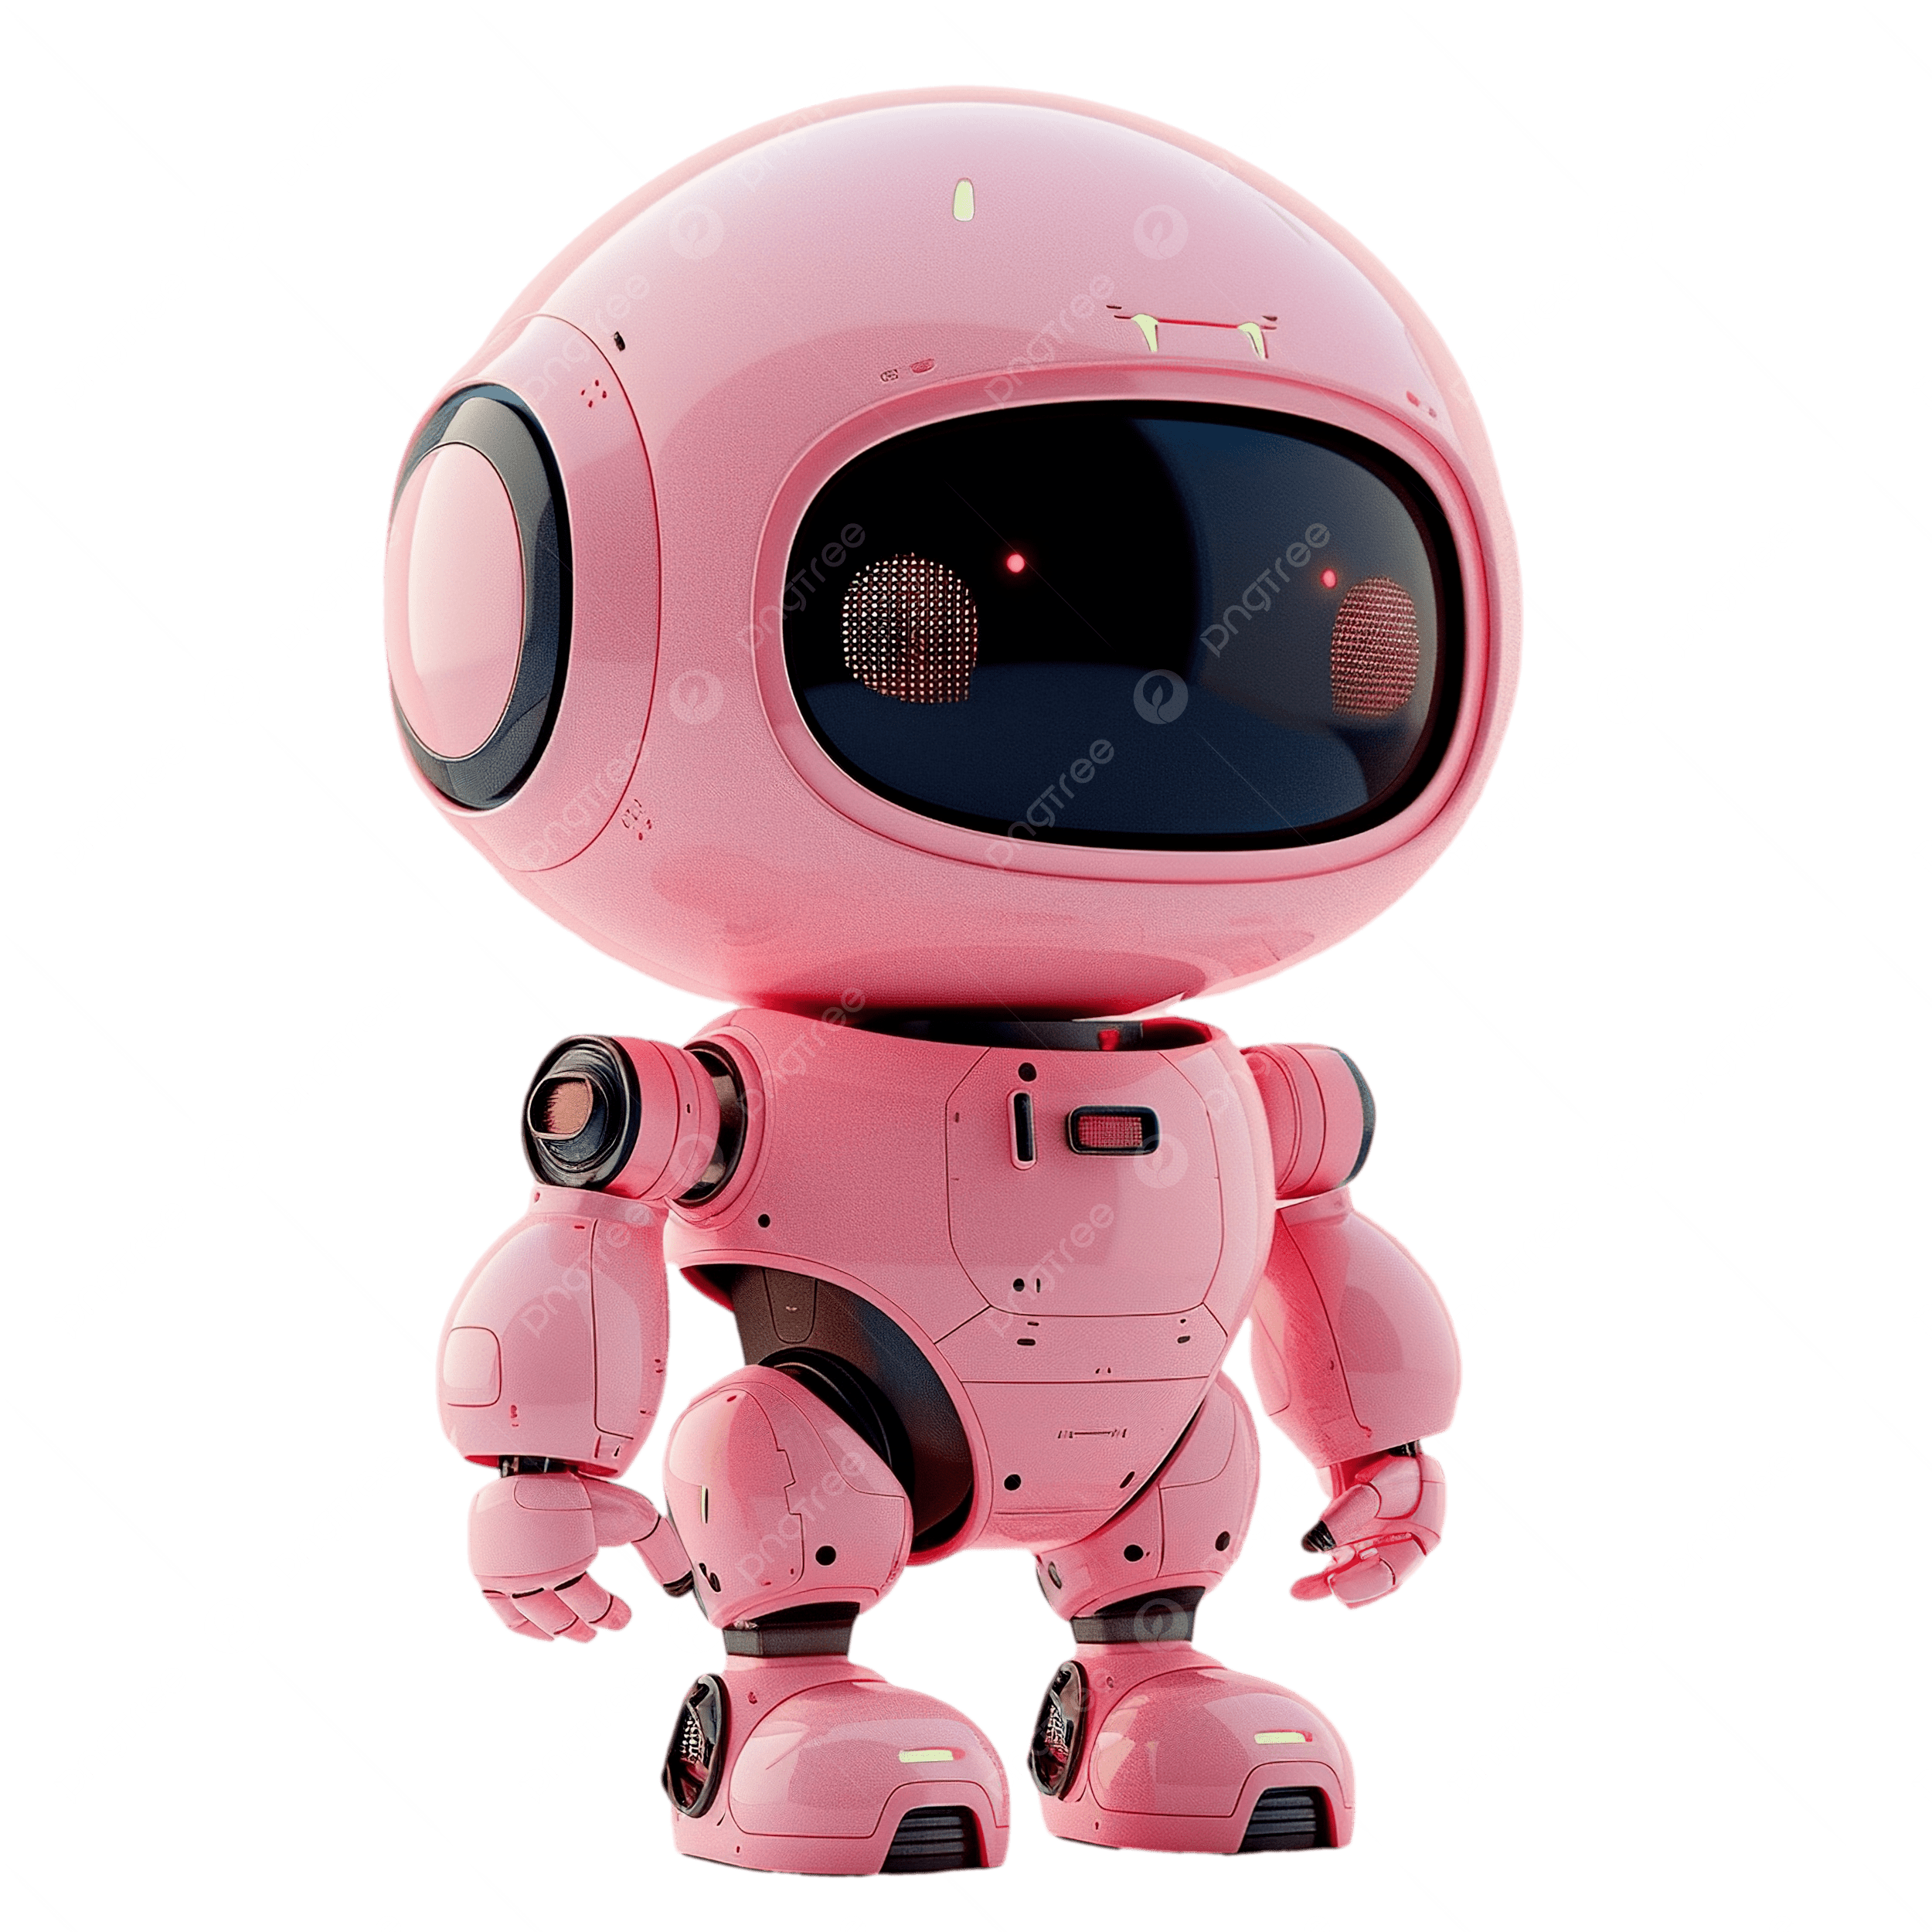
CONCLUSION
This project creates the world’s first AI-powered holographic resume — a futuristic digital portfolio that is unforgettable, innovative, and beyond the traditional resume system.

Slide 12

Link here
@https://github.com/Priyanila-07

Slide 13

